Slide 1
Programming Fundamentals
By
Shazmeen Batool

Slide 2
Today’s Lecture
Identifiers
Variables
A Simple C++ Program

Slide 3
Identifier?
Identifiers are the unique names given to variables, classes, functions, or other entities by the programmer.
C++ is a case-sensitive language.
Work is not work
Identifiers should be descriptive
Using meaningful identifiers is a good programming practice.
For example:
int money;

Slide 4
Identifier?
Identifiers must be unique.
Identifiers cannot be reserved words (keywords)
double main return
Identifier must start with a letter or underscore, and be followed by zero or more letters (A-Z, a-z), digits (0-9), or underscores.
C++ does not allow punctuation characters such as @, $, and % within identifiers.
VALID
_taxRateY2K ageOfHorse
age_of_dog PrintHeading
NOT VALID
age# 2000TaxRate
Age-Of-Dog main

Slide 5
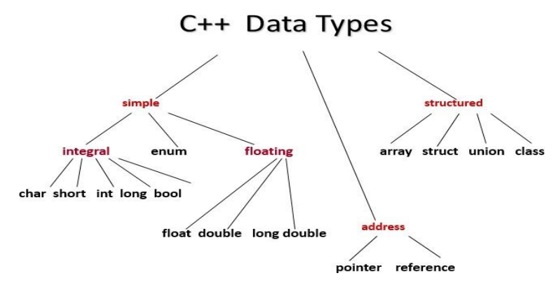
C++ Data Types

Slide 6
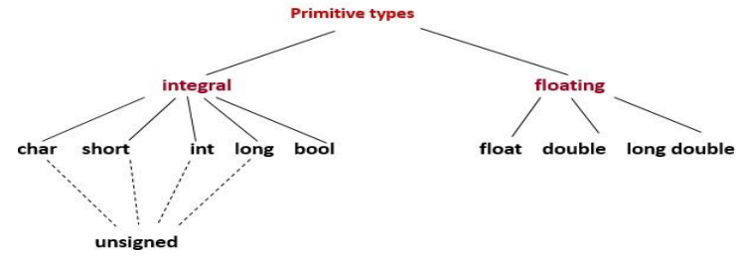
C++ Primitive Data Types
The built-in data types in C++, are known as the Primitive Data Types.

Slide 7
Primitive Data Types
Data Type | Meaning | Size (In Bytes)
int | Integer | 2 or 4
float | Floating-point | 4
double | Double Floating-point | 8
char | Character | 1
wchar_t | Wide Character | 2
bool | Boolean | 1
void | Empty | 0

Slide 8
Primitive Data Types
Several of the basic types can be modified using one or more of these type modifiers −
signed
unsigned
short
long

Slide 9
Type | Size | Typical Range
int | 4bytes | -2147483648 to 2147483647
unsigned int | 4bytes | 0 to 4294967295
signed int | 4bytes | -2147483648 to 2147483647
short int | 2bytes | -32768 to 32767
unsigned short int | 2bytes | 0 to 65,535
signed short int | 2bytes | -32768 to 32767
long int | 4bytes | –2,147,483,647 to 2,147,483,647
signed long int | 4bytes | same as long int
unsigned long int | 4bytes | 0 to +4,294,967,295
long long int | 8bytes | -(2^63) to (2^63)-1
unsigned long long int | 8bytes | 0 to 18,446,744,073,709,551,615
Note: Above values may vary from compiler to compiler.

Slide 10
Type | Size | Typical Range
float | 4bytes | Negative range: -3.4028235E+38 to -1.4E-45 Positive range: 1.4E-45 to 3.4028235E+38
double | 8bytes | Negative range: -1.7976931348623157E+308 to -4.9E-324 Positive range: 4.9E-324 to 1.7976931348623157E+308
long double | 12bytes | Same as double
char | 1 byte | -128 to 127
signed char | 1 byte | -128 to 127
unsigned char | 1 byte | 0 to 255
wchar_t | 2 or 4 bytes | 0 to 65535
Note: Above values may vary from compiler to compiler.

Slide 11
Primitive Data Types in C++
Integral Types
Represent whole numbers and their negatives.
Declared as int, short, or long
Character Types
Represent single characters.
Declared as char.
Stored by ASCII values.
Boolean Type
Declared as bool.
Has only 2 values true/false.
Floating Types
Represent real numbers with a decimal point
Declared as float, or double
Scientific notation where e (or E) stand for “times 10 to the ” (.55-e6)

Slide 12
Samples of C++ Data Values
int sample values
4578 -4578 0
bool values
True false
float sample values
95.274 95.0 .265
char sample values
‘B’ ‘d’ ‘4’ ‘?’ ‘*’

Slide 13
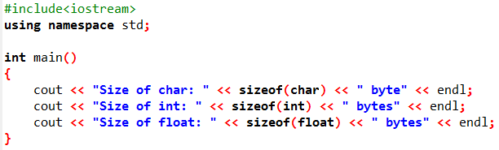
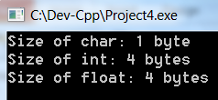
sizeof()
The sizeof is a keyword refers to an operator that determines the size, in bytes, of a variable or data type.
Output:

Slide 14
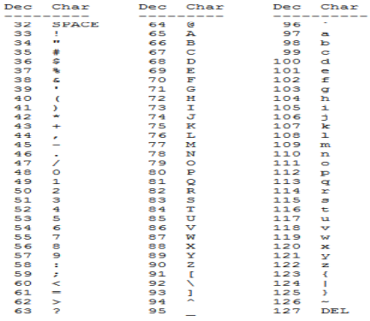
ASCII Table

Slide 15
Variable
A variable is a memory address where data can be stored and changed.
Declaring a variable means specifying both its name and its data type.
All variables must be declared with a name and a data type before they can be used in a program.

Slide 16
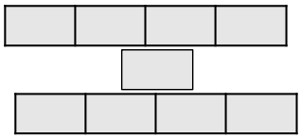
What Does a Variable Declaration Do?
A declaration tells the compiler to allocate enough memory to hold a value of this data type, and to associate the identifier with this location.
int ageOfDog;→
char middleInitial; →
float taxRate;→

Slide 17
Variable Declaration
All variables must declared before use.
At the top of the program
Just before use.
Commas are used to separate identifiers of the same type.
int count, age;
Variables can be initialized to a starting value when they are declared.
int count = 0;
int age, count = 0;

Slide 18
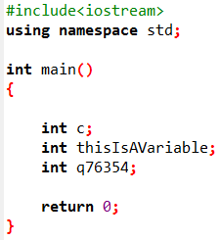
Activity
Declare the variables c, thisIsAVariable, q76354 and number to be of type int.

Slide 19
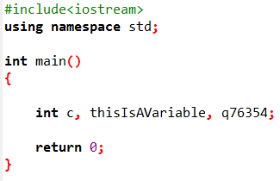
Activity
Declare the variables c, thisIsAVariable, q76354 and number to be of type int (in one statement).

Slide 20
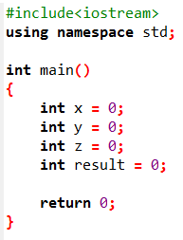
Activity
Declare the variables x, y, z and result to be of type int (in separate statements) and initialize each to 0.

Slide 21
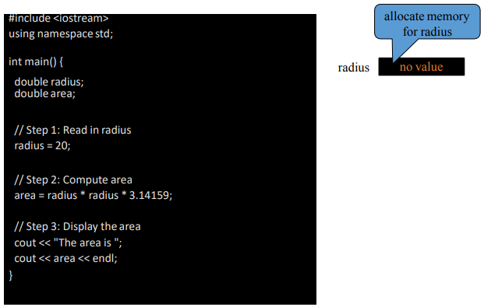
Trace a Program Execution

Slide 22
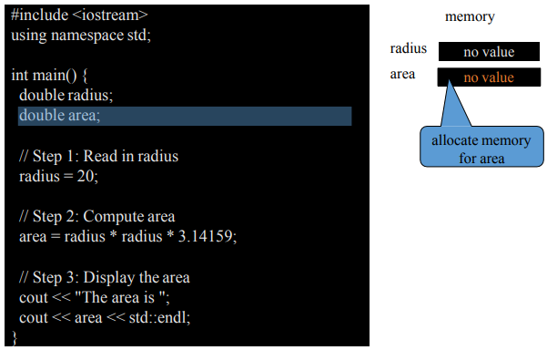
Trace a Program Execution

Slide 23
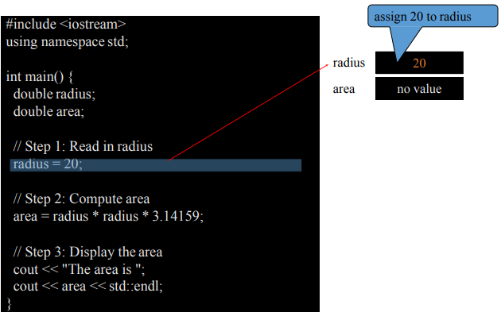
Trace a Program Execution

Slide 24
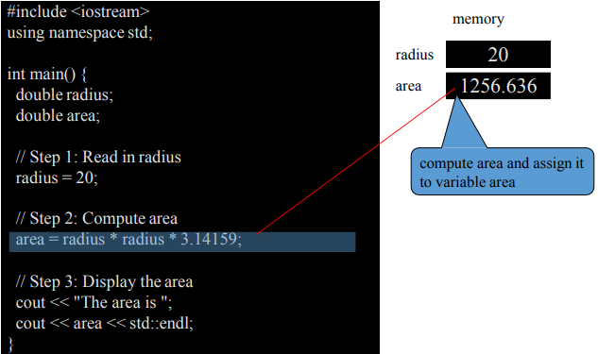
Trace a Program Execution

Slide 25
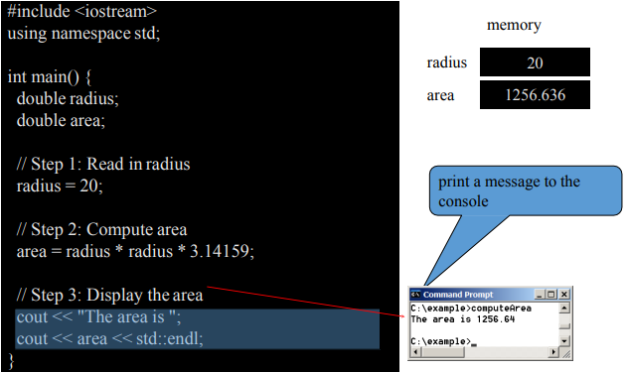
Trace a Program Execution

Slide 26
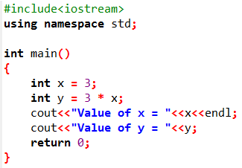

Example
Output

Slide 27
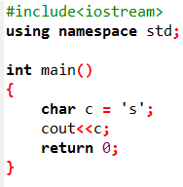
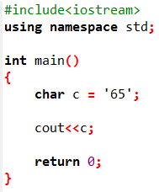
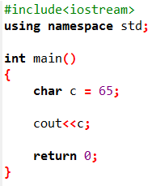
char Data Type
The char data type is used to store a single character. The character must be surrounded by single quotes, like 'A' or 'c':

Slide 28
Next Lecture
Conditional Statements

